Slide 1

Custom Validators & Directives
Timmy K Tom Tata Consultancy Services

Slide 2
Custom Validator and use it in a Reactive Form
Accessing ‘ValidationErrors’ for a FormControl to show Validation Messages
Custom Validator with arguments and use it in a Reactive Form
Custom Validator Directive for Model driven Form
Multi Providers & Forward References in Angular

Slide 3
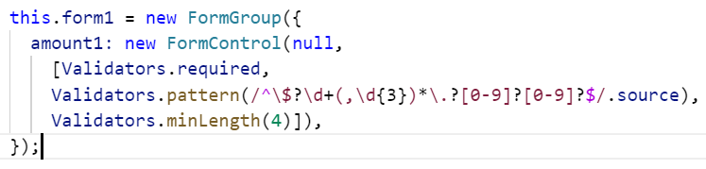
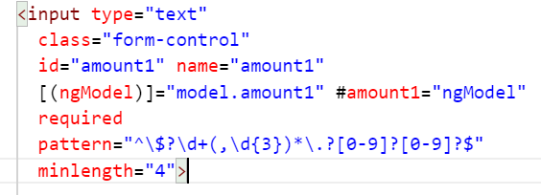
Validator:
A validator is a function that processes a FormControl and returns a map of errors. Every time the value of a form control changes, Angular runs validation and generates either a list of validation errors, which results in an INVALID status, or null, which results in a VALID status.
Reactive Form
Model Driven Form

Slide 4
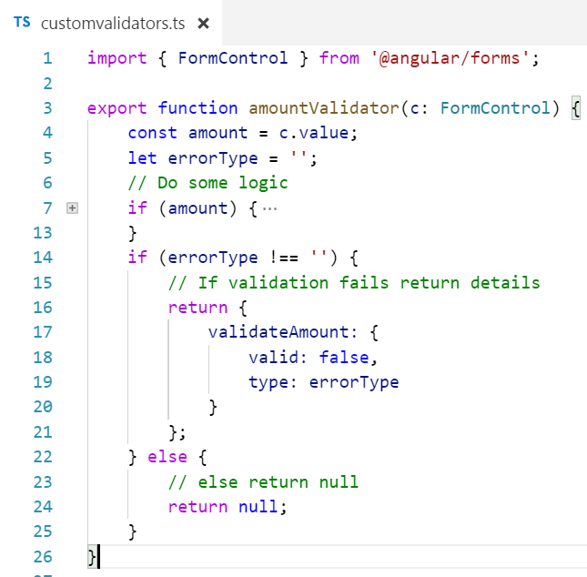
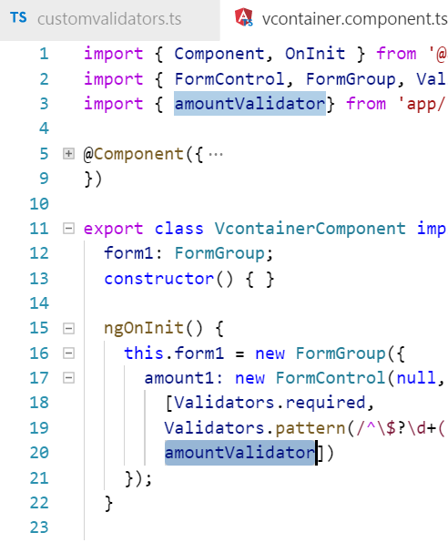
Custom Validator
Use with Reactive Form

Slide 5
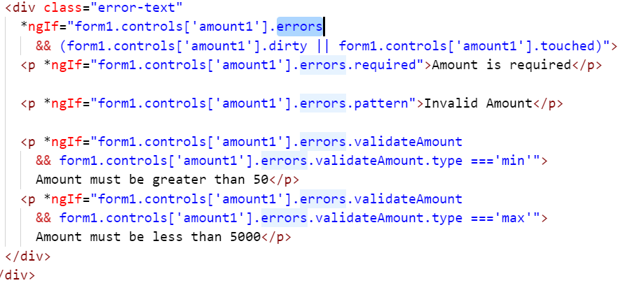

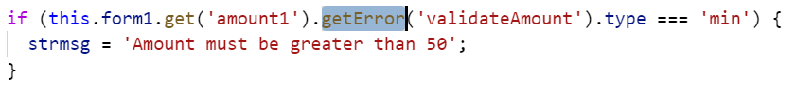
Accessing FormControl ‘ValidationErrors’

Slide 6
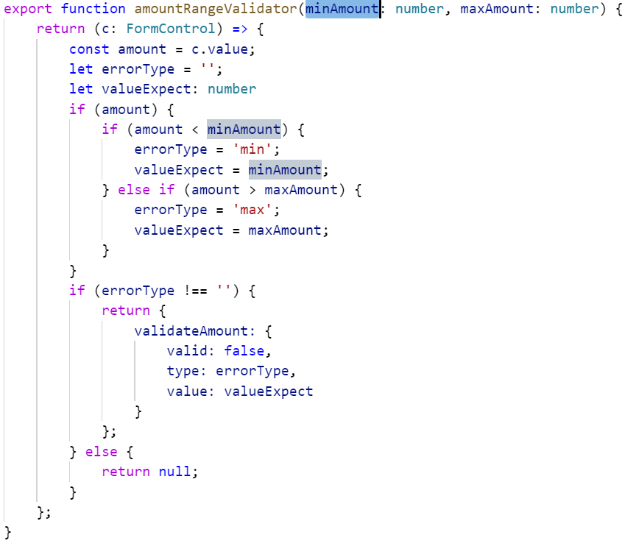
Custom Validator with arguments

Slide 7
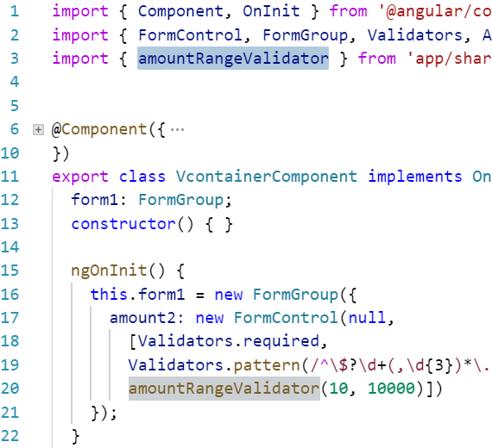
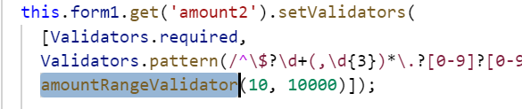
Calling Custom Validator with arguments in Reactive Form

Slide 8
Directives
Components - directives with a template <my-custom-component-dir></my-custom-component-dir>
Structural Directives - change the DOM layout by adding and removing DOM elements. <p *ngIf="form1.controls['amount1'].errors.pattern">Invalid Amount</p> <ul> <li *ngFor="let hero of heroes">{{hero.name}}</li> </ul>
Attribute Directives - change the appearance or behavior of an element, component

Slide 9
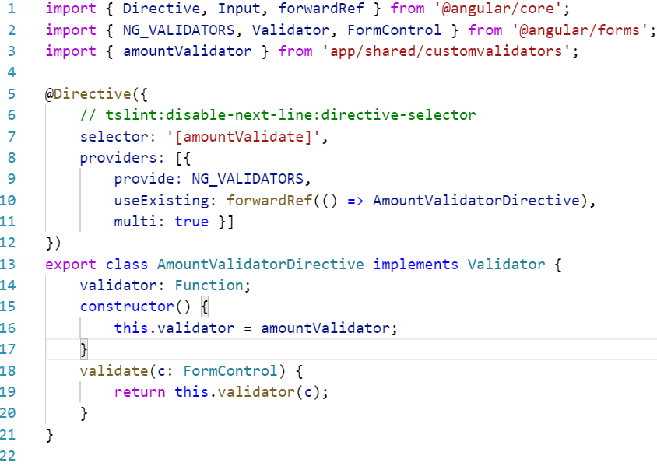

Custom Directive using Custom Validator without dependency
Directive
NG_VALIDATORS
Validator

Slide 10
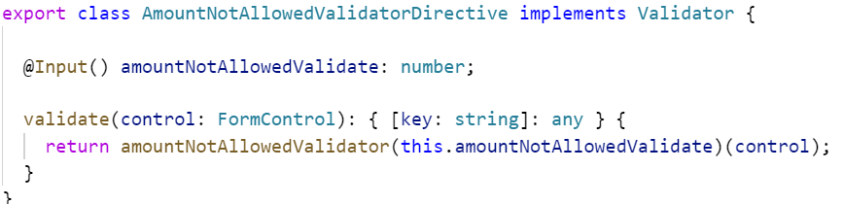
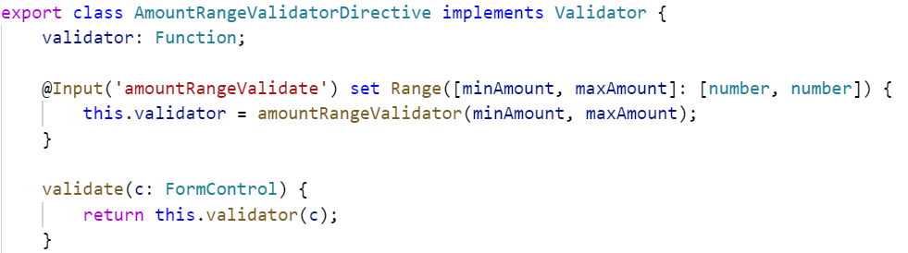
Custom Directive using Custom Validator with dependency
Single value
Multiple value

Slide 11
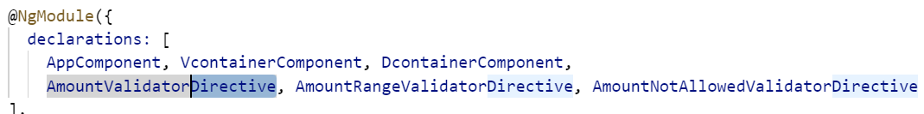
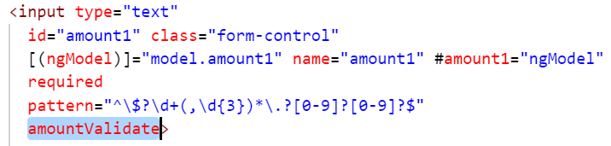
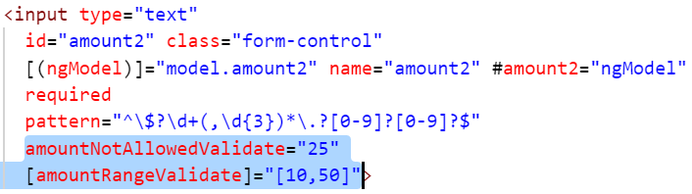
Using Custom Directive
Add Directives to App/Shared module declarations
Use the respective selectors of the Directives in the Form controls

Slide 13
Thank You
https://angular.io/guide/form-validation
https://blog.thoughtram.io/angular/2016/03/14/custom-validators-in-angular-2.html#custom-validators-with-dependencies

